Slide 1
GEOG0114: Principles of spatial analysis
WEEK 10: REVISION
Dr Anwar Musah (a.musah@ucl.ac.uk)
Lecturer in Social and Geographic Data Science
UCL Geography
1

Slide 2
The Beginning: Introduction to Spatial Analysis and Data Science
Summary of GEOG0114
2

Slide 3
What have we covered in the last 9 weeks…
Week | Weekly Topics
1 | Spatial Analysis for Data Science
2 | Graphical Representation of Spatial Data
3 | Spatial Autocorrelation
4 | Suitability Mapping: Part I (Qualitative approach)
5 | Suitability Mapping: Part II (Quantitative approach)
Reading Week (Assessment)
6 | Geostatistics using Kriging
7 | Spatial Models: Part I (Spatial Lag & Error Models)
8 | Spatial Models: Part II (Geographically Weighted Regression)
9 | Spatial Models: Part III (Spatial Risk Models)
10 | Summary of GEOG0114
3

Slide 4
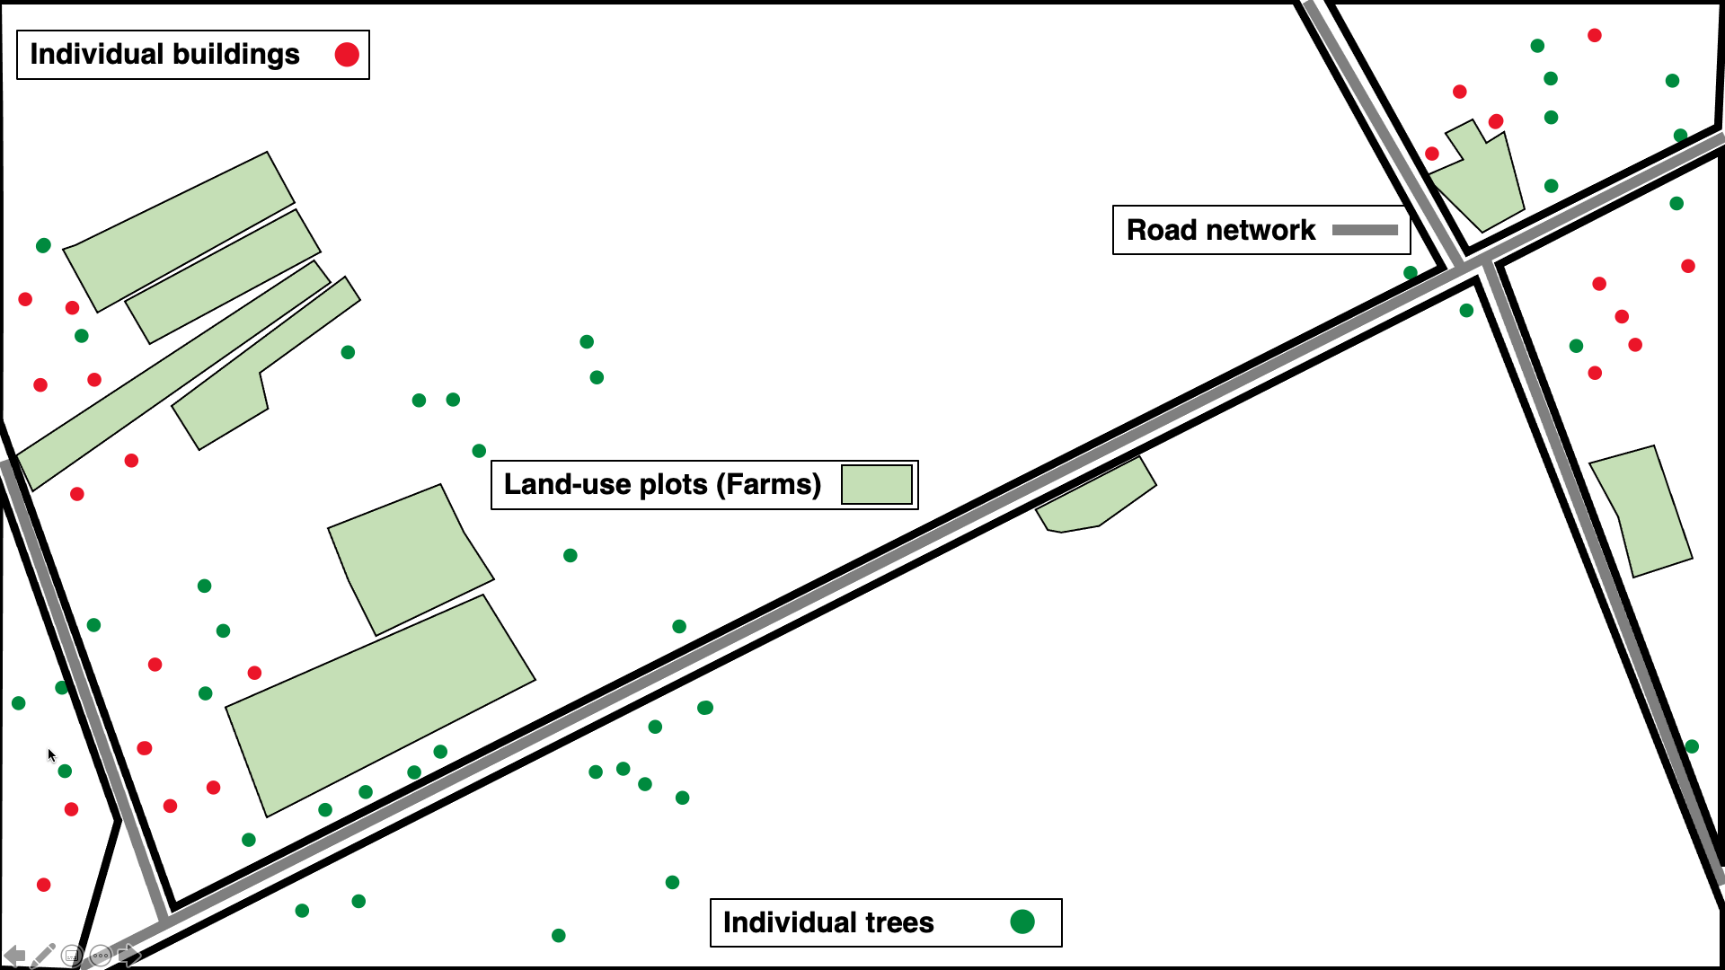
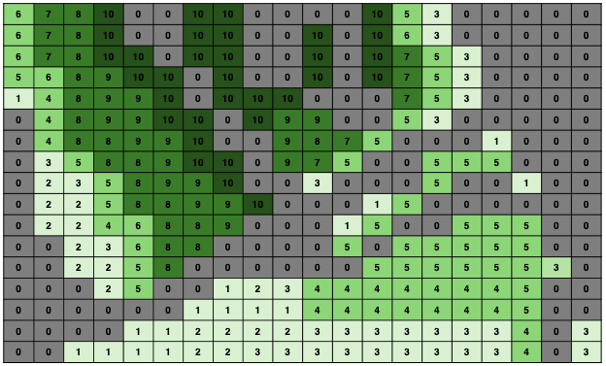
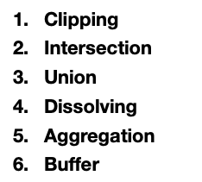
Week 2: Graphical Representation of Spatial Data
Vector data
Raster data
Geoprocessing Techniques
4

Slide 5
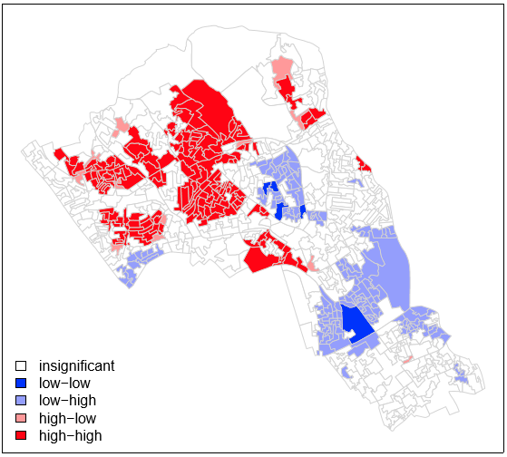
Week 3: Spatial Autocorrelation & Dependence
Global Test
Generate the hypothesis
Null hypothesis: The patterns are random
Alternative hypothesis: The patterns are not random (i.e., clustered/dispersed).
How to perform Global Moran’s I test to get a p-value to accept, or reject the null hypothesis
Result (Global Moran’s I = 0.5448 [p=0.0001 < 0.05])
Local Test
This is what we want. The p-values helps us to know whether the LISA estimates are statistically significant or not.
5

Slide 6
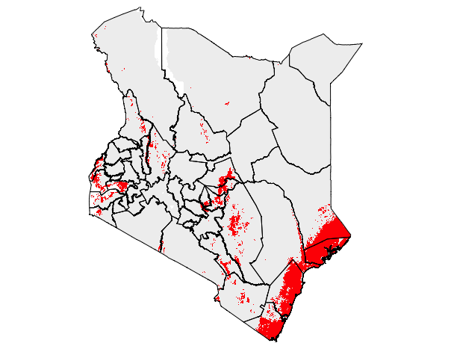
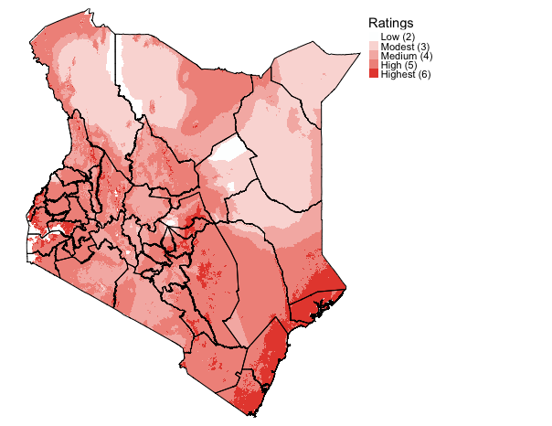
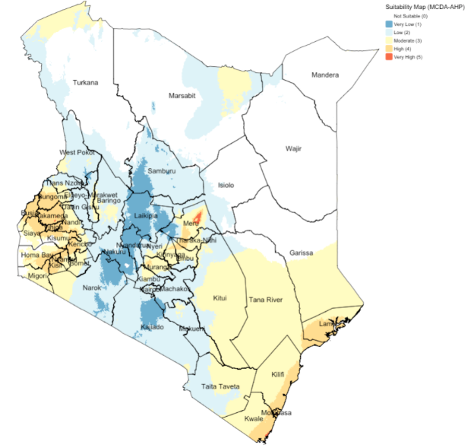
Week 4: Suitability Mapping I
Simple Overlays: Booleans & Rankings
Multi-Decision Criteria Analysis
6

Slide 7
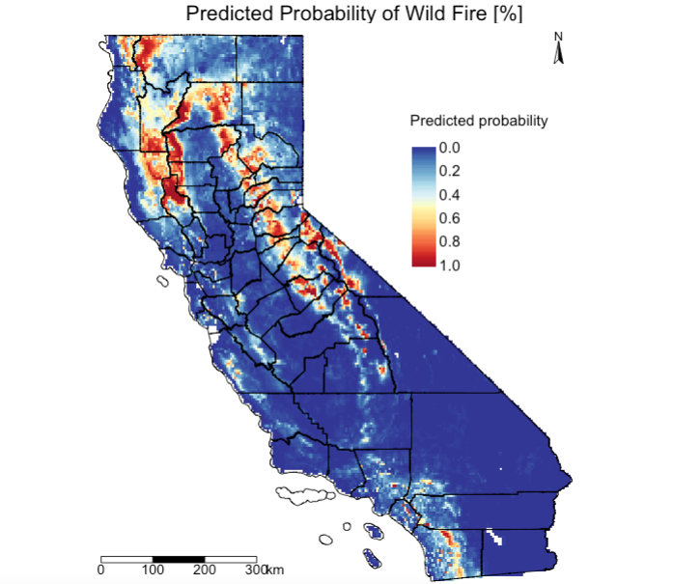
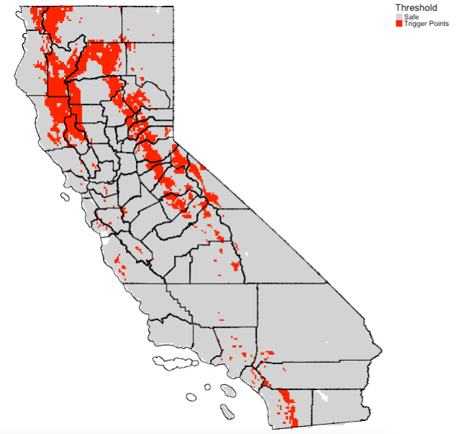
Week 5: Suitability Mapping II
Ecological Niche Models
We mapped predicted probability of fires using the trained model after making sure its valid. The multi-band raster is fed to the trained model to make full scale predictions.
This is based on the optimized estimate obtained after model validation i.e., maximizes the True Positive Rate and the True Negative Rate is 0.4054474 (40.55%). Here, we mapped predicted probability > 0.4054 as a reclassified raster.
7

Slide 8
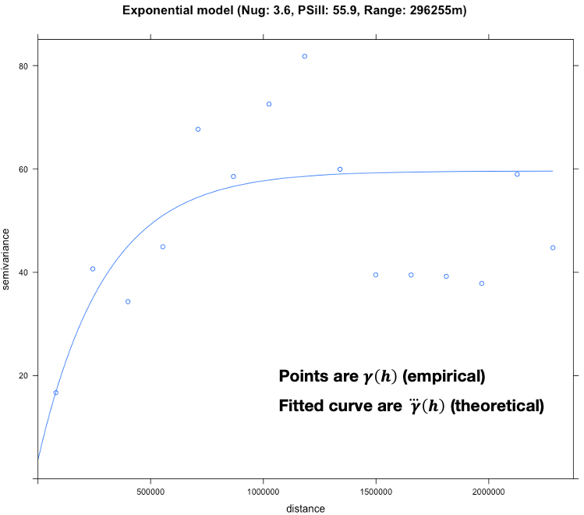
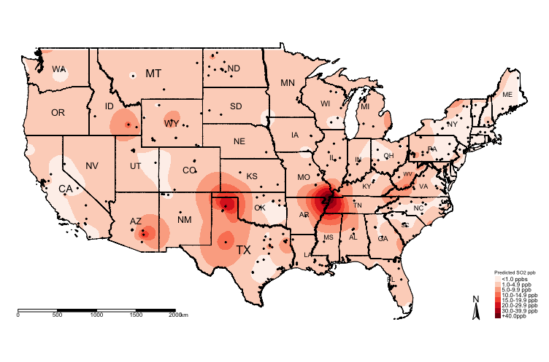
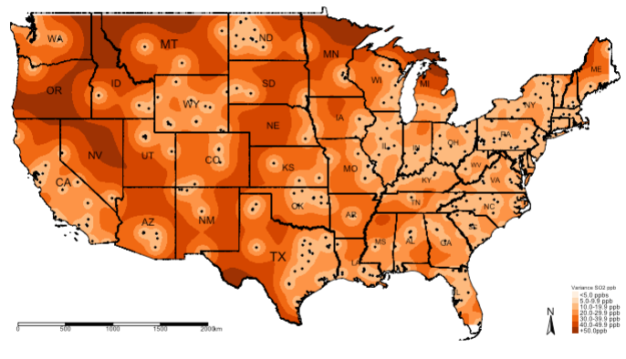
Week 6: Geostatistical Modelling
Variogram analysis
Predicted air SO₂ level from the
Kriging model
Uncertainty for the predicted air SO₂
levels from the Kriging model
Interpretation: The nugget is a small value of 3.6, which is an indication for evidence of spatial variability in the concentrations for SO₂ across sampling sites in USA. The range is 296,255m, which indicates that any separation distance above this value means that spatial autocorrelation in the observed levels of SO₂ between points are no longer similar. However, points with a separation distance less than 296,255m indicated that their SO₂ values are similar. For the partial sill, within this range for the Semivariance i.e., 3.6 and 55.9 – is the values are spatially autocorrelated.
Along the belt of the following states – Missouri, Tennessee, Kentucky and Illinois, the predicted concentration of SO₂ levels exceeds +40ppb, whereas there are pockets in Texas where concentrations of SO₂ are a cause for concern i.e., 30-39.9ppb.
8

Slide 9
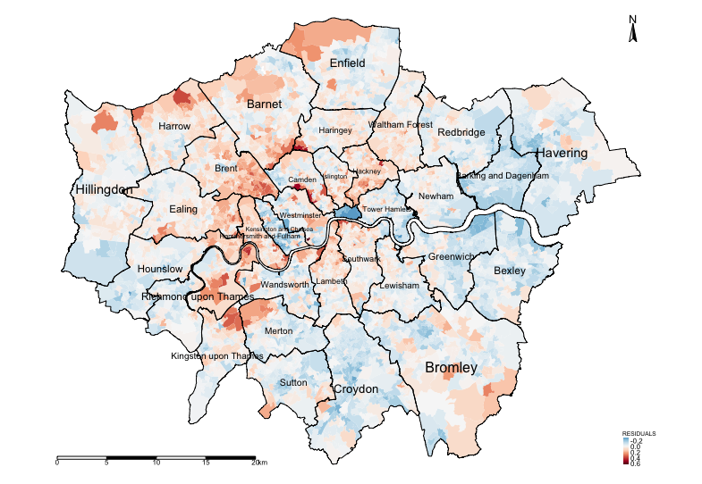
Week 7 and 8: Spatial Regression and GWRs [1]
Reporting the Global estimates
Modelled results in table are from Linear, Spatial Lag (Y) and GWR regression model
Variable(s) | Linear | Lag (Y) | GWR
log(Income) | 2.036* | 1.267* | 2.036
log(Deprivation) | 0.136* | 0.045* | 0.137
log(PTAL) | 0.031* | 0.011* | 0.030
AIC | -8510.8 | -9863.3 | -11242
R² | 0.7889 (78.89%) | N/A | 0.9318 (93.18%)
The GWR model is better than the linear and Spatial Lag regression. We take the model with the highest R-squared value, as well as the lowest AIC value.
Examining the residuals for determining spatial patterning and evidence of spatial autocorrelation. Moran’s I test was 0.475 (p < 0.001) meaning that the residuals are clustered.
Broadly, there’s an over-estimation in the house-price and spatial aspects needs to be accounted for.
9

Slide 10
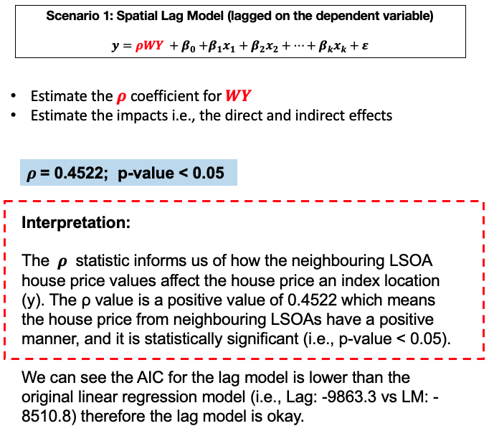
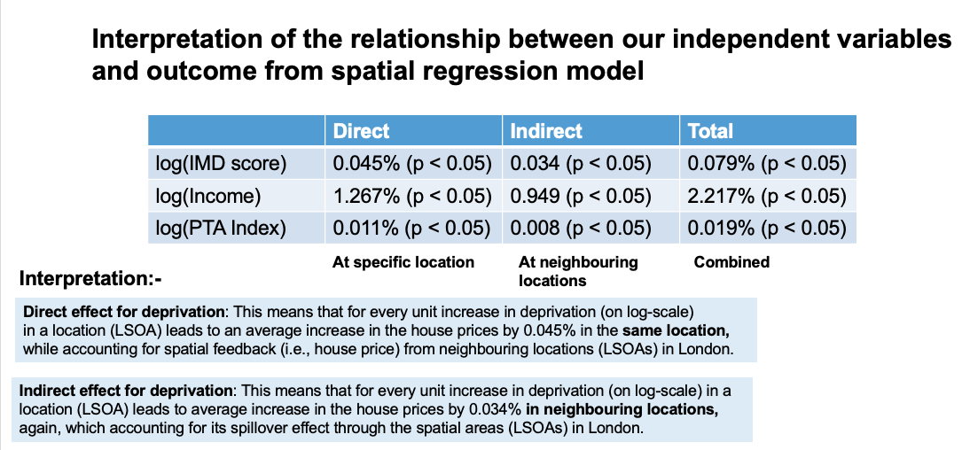
Week 7 and 8: Spatial Regression and GWRs [2]
[1] Report overall spatial effect
[2] Report the direct, indirect and total effects
10

Slide 11
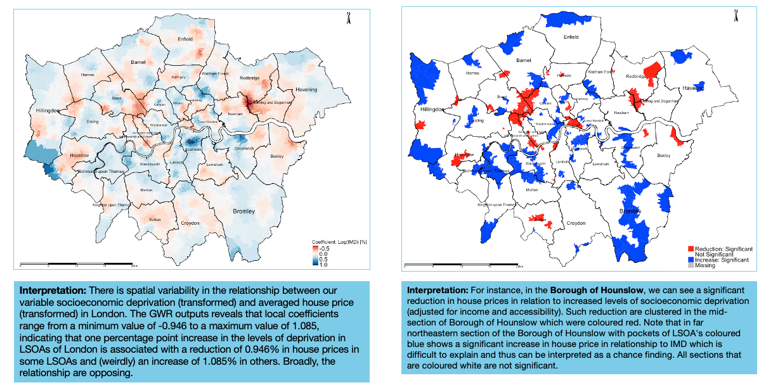
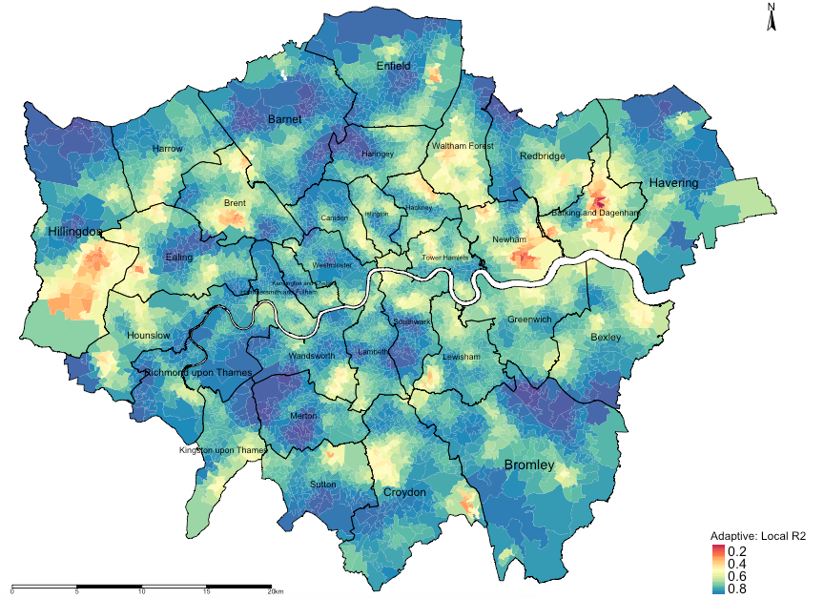
Week 7 and 8: Spatial Regression and GWRs [3]
[1] Local regression coefficients
[2] Statistical Significance
[3] Local R² : Model Diagnostics
Interpretation: The areas that are going towards the shade of dark reds (i.e., value of 0) are local regression models that have broadly performed poorly in its prediction for house price and its association with the three variables (income, deprivation and PTAL). Likewise, the areas that are going towards the shade of dark blues (i.e., value of 1) are local regression models that have broadly performed very well in its prediction for house price and its association with the three variables (income, deprivation and PTAL).
Note: These results are essential as the local R2 values of each area show the model’s ability to predict the explained variance in house prices caused by deprivation, income and accessibility for specific areas.
11

Slide 12
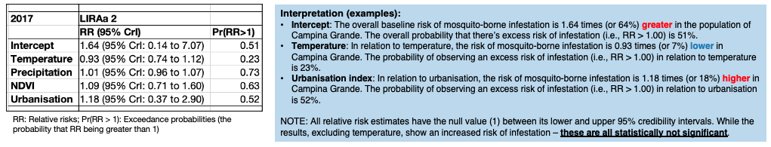
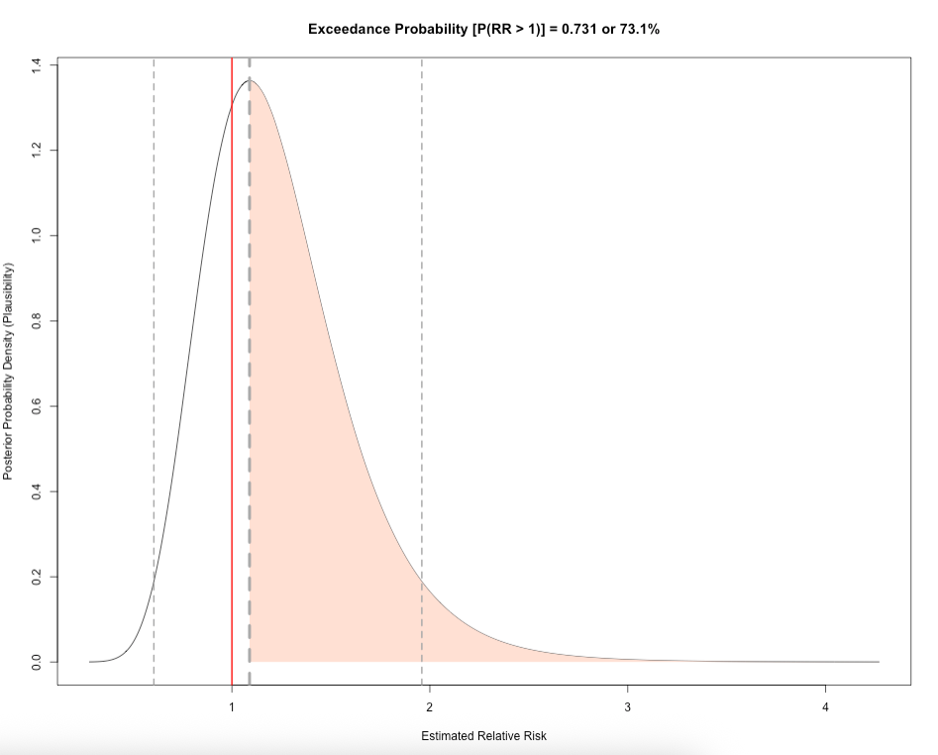
Week 9: Spatial Bayesian Risk Models [1]
Report the overall risk results
Describe the distribution of the relative risks
For the computer practicals, we showed all the possible values of how temperature is related to mosquito infestation in terms of impact and risk given the dataset we have. The relative risk for mosquito infestation given temperature can be anywhere from 0.278 (reduced risk) to 4.271 (increased risk). But from the graph, it indicates that the most plausible relative risk estimate is 1.089 because it has the highest density in our posterior distribution.
To guage levels of certainly about this estimated risk, we can calculate the probability that the relative risk is 1.089 or above. The probability of observing a relative risk of mosquito infestation being 1.089 or above, given the environmental levels of temperature, is 0.731 or 73.1%, which is quite high
12

Slide 13
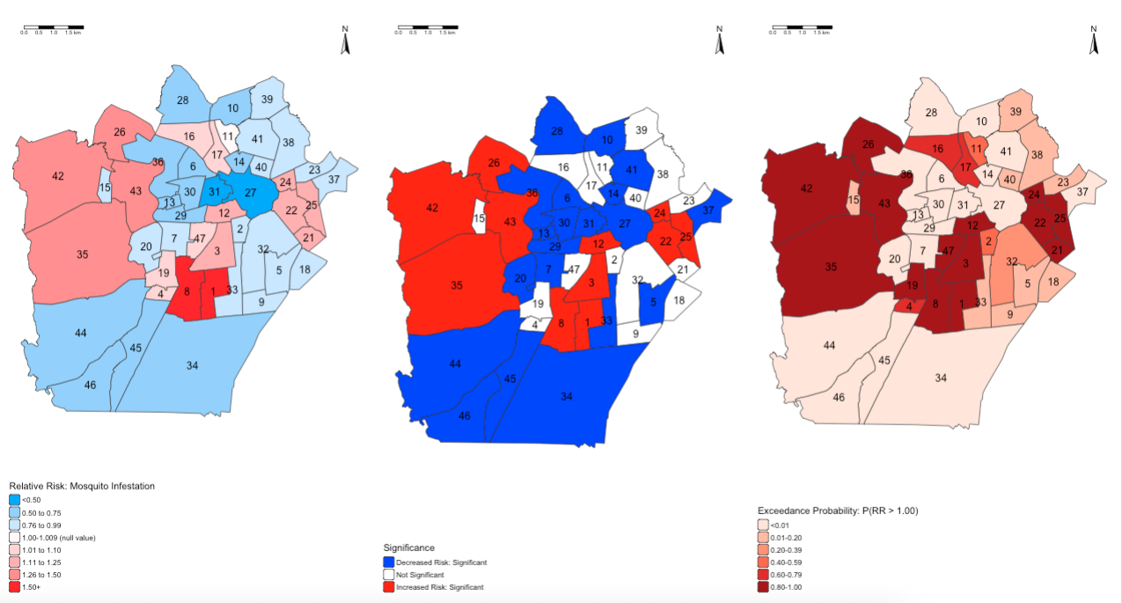
Week 9: Spatial Bayesian Risk Models [2]
[1] Area-specific risks
[2] Statistical Significance
[3] Exceedance Probabilities
13

Slide 14
The Beginning: Introduction to Spatial Analysis and Data Science
Assessment
14

Slide 15
Tips/Strategy for the Assignment
15
Overarching descriptive analysis of the raster or area dataset
Basic summary measures
Spatial distribution and patterning
Description about the dataset
Areal data
Raster-based analysis
What process does the point data follow?
Moran’s I test
LISA test
Geostatistical
Point Process
To make LISA interesting – we suggest exploring multiple outcomes to examine co-occurrence of clusters
Regression-Based Models
Ordinary/Regression Kriging
Ecological Niche Model
Linear Regression Models
Standalones
Rasters only, and you have no
point data?
Aggregated areal counts with
vector data, and you are interested
in risk?
Specialised Techniques!
Spatial Lag and Error Models
Analytical Hierarchical Process
Spatial Bayesian
Risk Model
[1] Geodemographics
[2] Accessibility analysis
Geographically Weighted Regression
15

Slide 16
Specialised Techniques
[1] Geodemographics
[2] Accessibility analysis
Geodemographics Classification (Week 7) taught on GEOG0114 by Dr Justin Van Dijk (Sabbatical)
This is a clustering technique. Geodemographic classification is a method used to categorise geographic areas and the people living in them based on demographic, socioeconomic, and sometimes lifestyle characteristics.
[1] Geodemographic Classification https://jtvandijk.github.io/GEOG0114/01-geodemographics.html
Other excellent tutorials
[2] Using R for Geodemographic Analysis https://rpubs.com/nickbearman/r-geodemographics
[3] Geodemographics https://rpubs.com/nickbearman/geodemographics
Accessibility Analysis (Week 8) taught on GEOG0114 by Dr Justin Van Dijk (Sabbatical)
This technique describes the ease with which individuals can reach places and opportunities, such as employment, public services, and cultural activities. We can utilise transport network data to quantify accessibility and characterise areas based on their accessibility levels.
[1] Accessibility Analysis https://jtvandijk.github.io/GEOG0114/02-network.html
[2] Introduction to Urban Accessibility: https://ipeagit.github.io/intro_access_book/
16
Notes:
Gengen and Grace – to read the intro

Slide 17
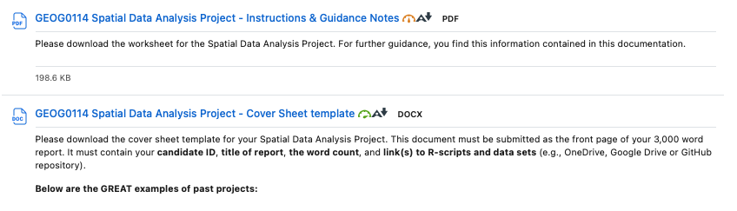
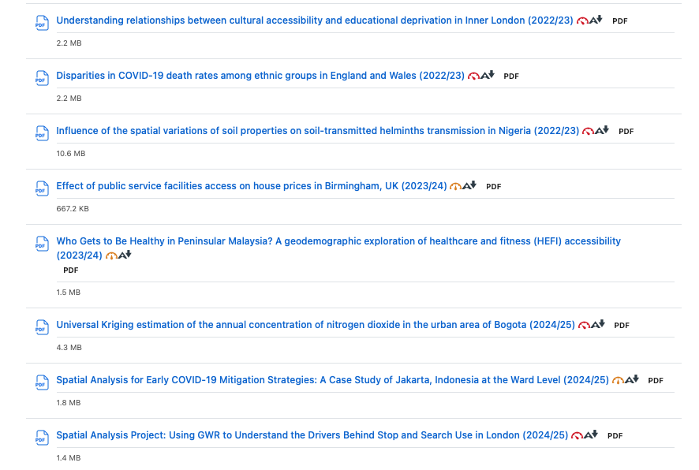
Go to Moodle’s Assessment
Assignment Documentation: Guidance notes and Cover Sheet
See Best examples of past projects from 2022/23 to present
PLEASE GO THROUGH THE DOCUMENTATION!
Spatial Data Analysis Project
Assignment’s deadline is Monday 12th January 2026 (by 12:00pm)
17

Slide 18
Example of Data Source(s)
UK Datasets
UK Census 2021: https://www.nomisweb.co.uk/sources/census_2021_bulk
UK Deprivation (2010, 2015) and 2019: https://www.gov.uk/government/statistics/english-indices-of-deprivation-2019
UK population 2010-2022 mid-year estimates: [LINK]
Police: https://data.police.uk/
CDRC (Geographic Data Service/Healthy and Sustainable Places): https://data.cdrc.ac.uk
London Data Store: https://data.london.gov.uk
DEFRA Air Pollution Information (real-time monitoring data) at all Automatic Urban & Rural Network stations. This dataset can be pulled into RStudio directly through an API using the R package openair (https://openair-project.github.io/book/)
Mosquito/species data
Global Biodiversity Information Facility: https://www.gbif.org
Global Mosquito Observatory Database (GMOD): https://experience.arcgis.com/experience/7228a5a27442468494caec2934c2b73d/page/Page/
Malaria Atlas Project: https://malariaatlas.org (main website) but all dataset can be pulled into RStudio directly through API using the R package malariaAtlas (https://github.com/malaria-atlas-project/malariaAtlas)
Disaster dataset
EM-DAT International Disaster Database: [LINK]
FIRMS Firm Information for Resource Management System: [LINK]
Humanitarian dataset
Humanitarian Data Exchange: https://data.humdata.org
Worldpop HUB: https://www.worldpop.org
Global Terrorism Database: https://www.start.umd.edu/gtd/
Armed Conflict Location and Event Data: https://acleddata.com
WHO-ESPEN Project containing tropical diseases in Sub-Saharan Africa:
https://espen.afro.who.int/ | https://espen.afro.who.int/tools-resources/cartography-database | https://espen.afro.who.int/tools-resources/download-data
Country shapefiles: https://gadm.org/download_country.html
Inspiration for writing methodology
Musah et al. (2020): https://doi.org/10.1016/j.apgeog.2019.102126
Todd et al. (2022): https://doi.org/10.1177/23998083211001836
Li et al. (2022): https://doi.org/10.1016/j.apgeog.2022.102718
I would advise finding your own dataset you are interested in.
18

Slide 19
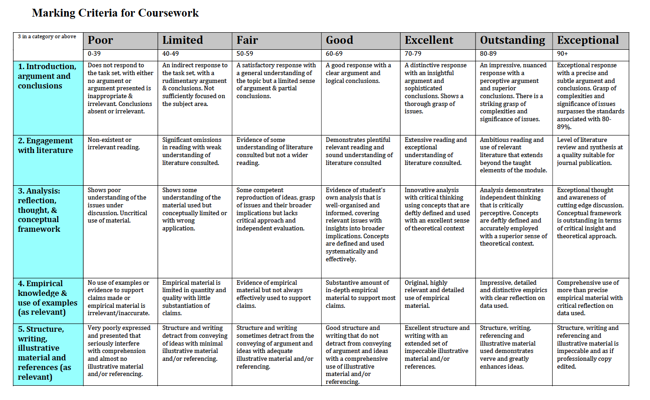
19

Slide 20
The Beginning: Introduction to Spatial Analysis and Data Science
Dos and Don’ts
20

Slide 21
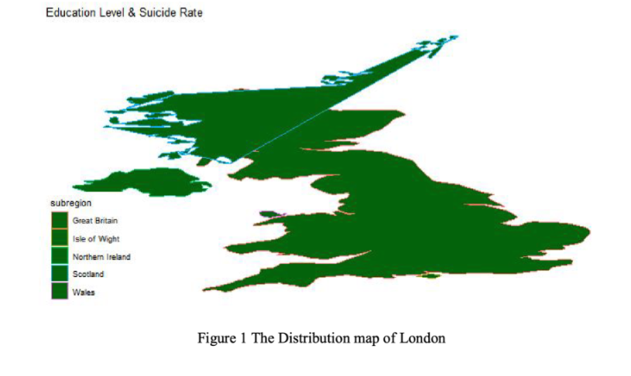
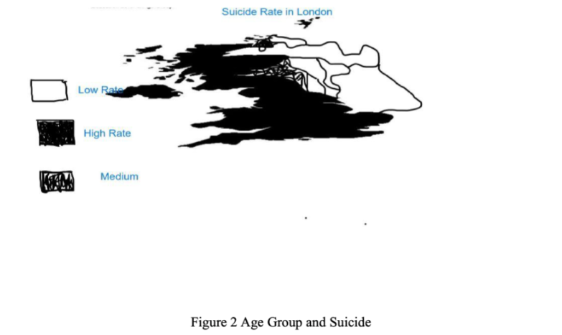
The ‘Dos’ and ‘Dont’s’
Make sure that your figures and tables are publication-worthy [1]
If you produce an image like this – it’s an automatic failure
21

Slide 22
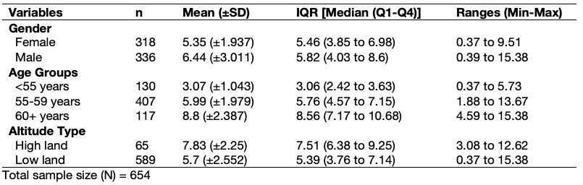
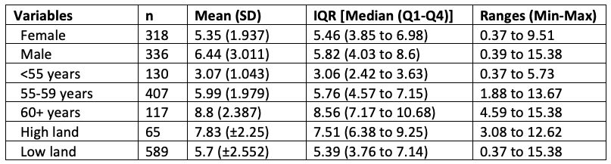
The ‘Dos’ and ‘Dont’s’
Make sure that your figures and tables are publication-worthy [2]
Best Standards:
Fully formatted table, with table legends which looks great, and it is of the standards that is considered publication-worthy. This type will yield you full marks i.e., correct results and show an eye for detail.
Table 2: Shows a descriptive analysis of the lung capacity function (i.e., volume) stratified by gender. Data is from among 654 respondents from the East Midlands.
Normal Standards:
Partially formatted table, with no table legends which looks rudimentary. No way near considered publication-worthy (i.e., in a report, research article, thesis etc.). The marker will be like “meh”… but if s/he (i.e., marker) is pissed-off or woke up on the wrong side of the bed, they may deduct marks.
22

Slide 23
The ‘Dos’ and ‘Dont’s’
Make sure that your figures and tables are publication-worthy [3]
# A tibble: 2 × 9
gender n mean sd median q1 q3 min max
<chr> <int> <dbl> <dbl> <dbl> <dbl> <dbl> <dbl> <dbl>
1 female 318 5.35 1.94 5.46 3.85 6.98 0.373 9.51
2 male 336 6.44 3.01 5.82 4.03 8.60 0.388 15.4
# A tibble: 3 × 9
agegroup n mean sd median q1 q3 min max
<chr> <int> <dbl> <dbl> <dbl> <dbl> <dbl> <dbl> <dbl>
1 <55 years 130 3.07 1.04 3.06 2.42 3.63 0.373 5.73
2 55-59 years 407 5.99 1.98 5.76 4.57 7.15 1.88 13.7
3 60+ years 117 8.80 2.39 8.56 7.17 10.7 4.59 15.4
# A tibble: 2 × 9
altitude n mean sd median q1 q3 min max
<chr> <int> <dbl> <dbl> <dbl> <dbl> <dbl> <dbl> <dbl>
1 high land 65 7.83 2.25 7.51 6.38 9.25 3.08 12.6
2 low land 589 5.70 2.55 5.40 3.76 7.14 0.373 15.4
Crap standards:
Not even worth the marker’s time.
If you want to alienate the markers, we dare you to submit an assignment with tables not formatted…
We double dare you to submit an output that is copied and pasted from R…
23

Slide 24
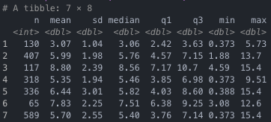
The ‘Dos’ and ‘Dont’s’
Make sure that your figures and tables are publication-worthy [4]
Really crap standards:
Even worse… we triple dare you to take a screenshot and paste it into your assignment…
24

Slide 25

“We will shut that sh*t down! No exceptions”
[Quote: Negan (The Walking Dead, Season 6, Episode 16 [Last Day on Earth])
25

Slide 26
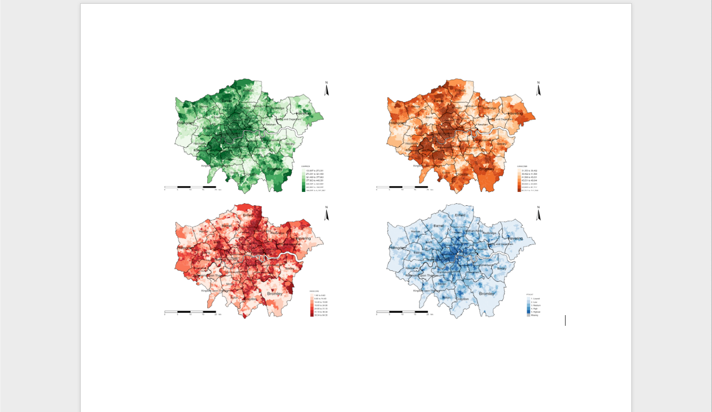
The ‘Dos’ and ‘Dont’s’
Readability of outputs and formatting of pages [1]
If you have multiple figure outputs, you are welcome to generate a panelled figure that is annotated alphabetically.
The issue is that squeezing a panelled figure on portrait document reduces it readability severely.
You should pay close attention to even these little things to avoid alienating your marker.
A
B
C
D
For the marker to make sense of this image, s/he
will be forced to zoom in the +400% any to still see
blurry figure…
26

Slide 27
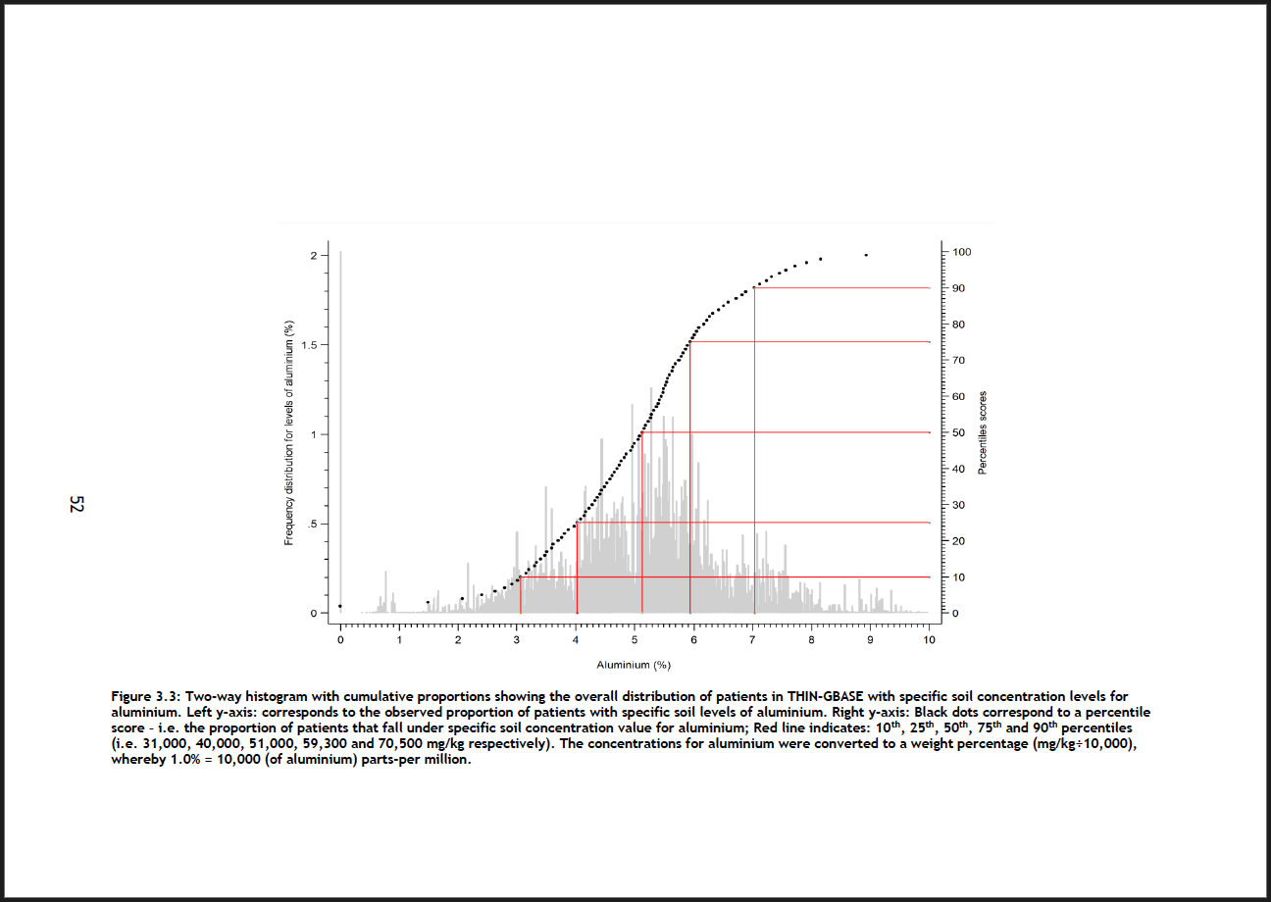
The ‘Dos’ and ‘Dont’s’
Show the image in its glory to the fullest by taking advantage of the landscape settings
Readability of outputs and formatting of pages [2]
This is a crude example to illustrate what I mean about showing your results nicely to its fullest glory.
Notice the page number has been formatted accordingly to the width of the page, instead of it being on the length to ensure consistency in the page number position if the document was printed.
Markers appreciate this level of eye-for-detail and are not above being sympathetic in awarding extra marks for quality in presentation.
27
Notes:
Flexibility with page numbers

Slide 28
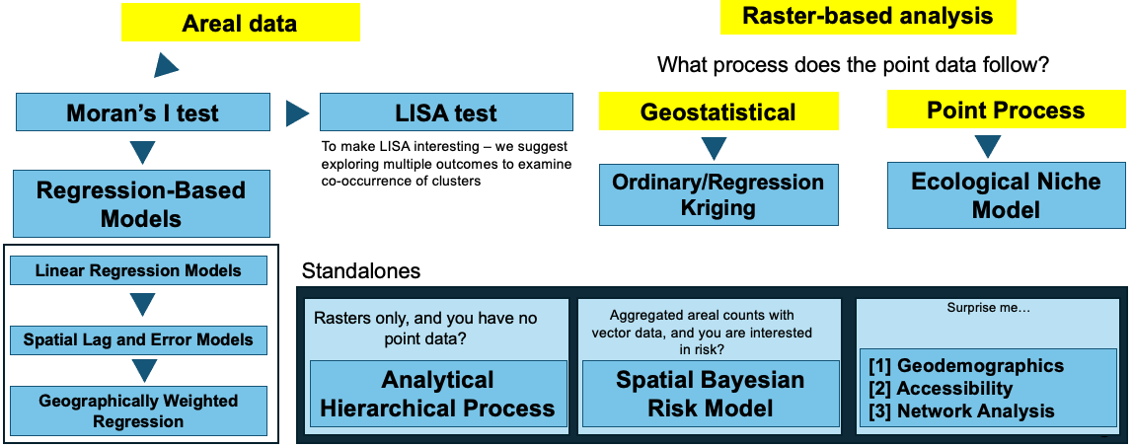
The ‘Dos’ and ‘Dont’s’
It’s a “Make” or “Break”
Avoid violating the core assumptions behind these analytical techniques
Any violation of the core assumptions – whether it be data-related, or distributional will be considered as a CRITICAL ERROR.
Marks will be deducted accordingly. It should be noted that your marks are capped at 68/69. Meaning you won’t be able to achieve anything past a 68/69. There is no way a distinction mark is awarded to a piece of work where CRITICAL ERRORS are present!
If it’s a horrible violation, to such an extent its irredeemable, then in such scenario can potentially lead to a failing grade.
28
Notes:
I just want to be clear – if you have no critical errors but somehow you’ve got a marks in the 50s/60s – it means that your work was underwhelming i.e., narratively.

Slide 29
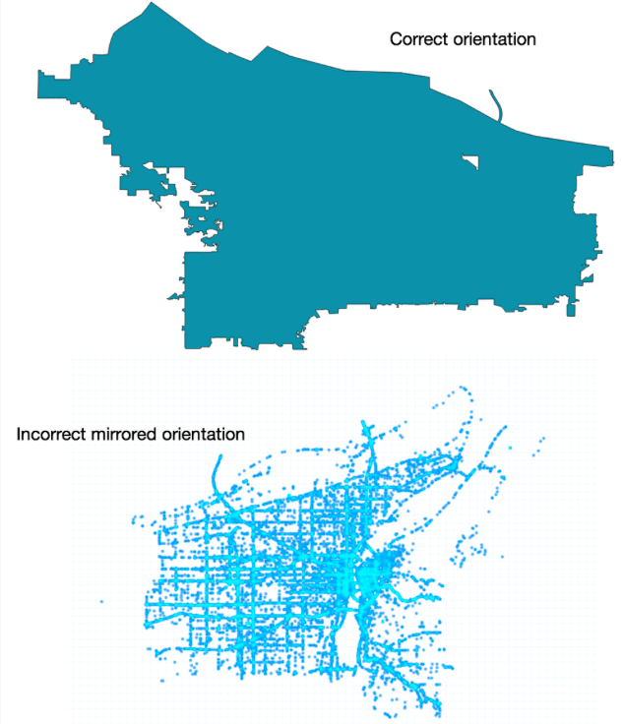
The ‘Dos’ and ‘Dont’s’
It’s a “Make” or “Break”
Make sure to understand the structure of your dataset and due diligence in the data cleaning!
Make sure the orientation of you layer and points are correct
Make sure longitude and latitude are in correct order, and not flipped or mirrored!
Make sure to use the correct Coordinate Reference System (CRS)
If the data quality is poor from the original source – especially with the points – clean it to the best of your ability by removing the broken points and retaining those that are accurate. DO NOT ATTEMPT TO ALTER THE POINTS IN ANYWAY AS YOU RISK INTRODUCING MORE PROBLEMS.
Shapefiles for areas as well, after you’ve cleaned them and linked with non-spatial data shouldn’t have holes in them
If you run an analysis with these problems, them it means that you have not learned anything on stuff we’ve covered together on data handling.
I consider this to be a critical error, which compromises the result. This type of horrible mistake, in my view, is irredeemable, so in such scenario we are look at a failing grade.
29

Slide 30
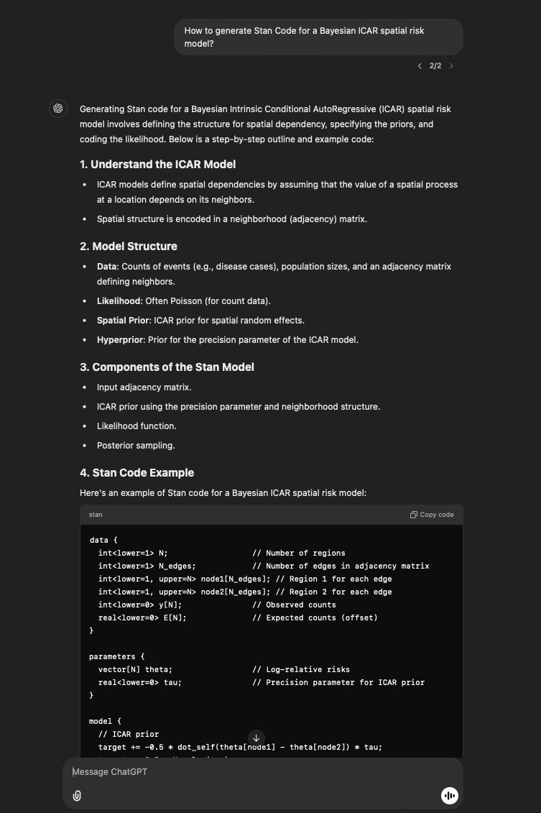
The ‘Dos’ and ‘Dont’s’
Use of Generative AI (e.g., ChatGPT) and References [1]
If you're using GenAI to assist or troubleshoot with the R coding part of the assessment, that's perfectly fine. You just need to acknowledge the use of GenAI in your methodology section, especially if it was used for straightforward tasks like data cleaning or manipulation.
“I acknowledge the use of ChatGPT (https://chatgpt.com/) to improve my writing, and assistance with R coding”
However, if GenAI was used for more significant contributions, such as getting information to describe the statistical methodology or modelling approach, you must provide a proper citation. UCL offers guidelines on how to cite GenAI in such cases. For example, if I asked ChatGPT the following:
“How to generate Stan Code for a Bayesian ICAR spatial risk model?”
How to generate Stan Code for a Bayesian ICAR spatial risk model? (2024). ChatGPT (GPT-4o). Wednesday, 27 November. Available at: https://chatgpt.com/c/67471449-f31c-800c-a6e9-f22b554f7841
UCL Policy on referencing GenAI [LINK]
UCL Geography’s Policy on using GenAI in MSc assessments/Dissertations [LINK]
30

Slide 31
The ‘Dos’ and ‘Dont’s’
It’s a “Make” or “Break”
Use of Generative AI (e.g., ChatGPT) and References [1]
DO NOT USE AI TO FULLY GENERATE YOUR REPORT OR REFERENCE LIST!
Automatic failure and UCL disciplinary action & punishment would be taken against you.
31

Slide 32
The Beginning: Introduction to Spatial Analysis and Data Science
References
32

Slide 33
Use a Reference Management Tool
Reference management software can save a lot of time, and heartache, when dealing with research papers and citation in text.
The following a popular tools:
Zotero: Free, intuitive, and it integrates with various browsers (Explorer, Safari, Mozilla, Chrome etc.,) and word processors
Mendeley: Free tool akin to Zotero - provides collaborative options between users (e.g., sharing of papers, references etc.)
EndNote: Paid but offers advanced features for professional use
BibTeX: Reference manager for programmatic software systems like Overleaf, RMarkdown, Quarto or LaTeX.
33

Slide 34



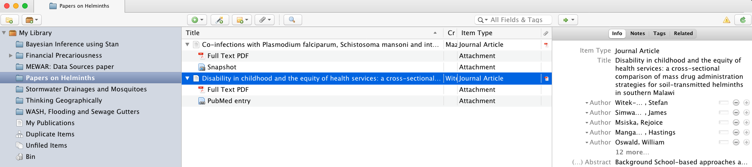
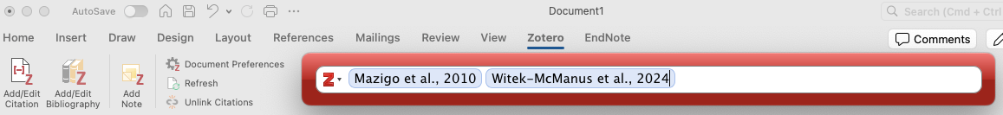
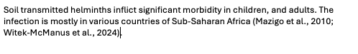
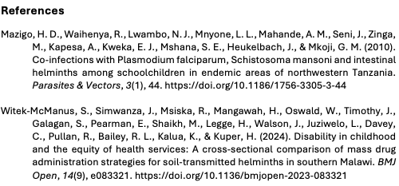
Literature review for the research question:
What is the geographical burden of soil-transmitted helminths in Sub Saharan Africa?
[1.] This button exports the paper into your reference manager
[2.] The user interface of reference manager. You can manage your list of references efficiently, and even read, annotate and categorise papers accordingly to the research theme for literature review
[3.] Reference manager is automatically connected to your word processor (e.g., Microsoft Word), which allows the efficient use of adding in-text citation and building your list of references on the fly.
[4.] The output will be a word document two things: a) body of text with in-text citation and b) bibliography at the end of the document.
34
Notes:
Show how to use the software if time permits it.

Slide 35
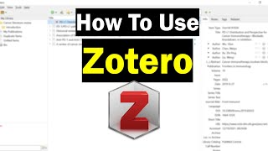
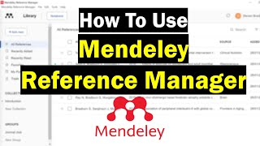
Guidance on setting-up free online reference management software
Useful video tutorials on Zotero and Mendeley
35

Slide 36
Any questions?
36

Slide 37

See you in Term 2
37

